Slide 1
CyberSkills2Work The National Cybersecurity Workforce Development Program

Slide 2
Industrial Control Systems Security
Acknowledgement
This program is funded by the National Security Agency National Centers of Academic Excellence in Cybersecurity (NCAE-C) Program.
For additional information, please visit www.CyberSkills2Work.org.
Course Title
CRN
©2024 CyberSkills2Work - Institution Name

Slide 3
Module 04 – ICS Wireless Protocols
Overview
Radio Frequency Primer
Radio Frequency Bandwidths
Wireless Technologies in ICS
Vulnerabilities in Wireless Technologies
Wireless Security Threat Modeling
Implementing Wireless Security Features
Case Study - FIUs Wireless ICS Testbed
Course Title
CRN
©2021 CyberSkills2Work - Institution Name

Slide 4
Radio Frequency (RF) Primer
RF is part of the electromagnetic (EM) spectrum, from ~3 kHz to 300 GHz
EM waves propagate as oscillating electric and magnetic fields
Key parameters: frequency, wavelength, amplitude, and phase
Wave behavior: reflection, diffraction, absorption, interference
Used for wireless communication through antennas
Notes:
Instructor Notes:
Radio Frequency (RF) is a portion of the electromagnetic spectrum commonly used for wireless communication.
RF waves are oscillating electric and magnetic fields that propagate through space. Frequency is how often the wave oscillates per second and determines the energy and penetration. Wavelength is the distance between wave peaks, amplitude relates to signal strength, and phase indicates the wave's alignment.
RF waves can reflect, diffract, and be absorbed by materials, and are transmitted and received through antennas.

Slide 5
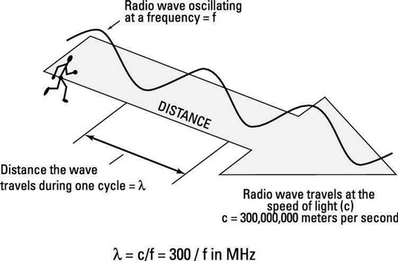
Radio Frequency Continued
Notes:
Instructor Notes:
This image illustrates the relationship between the speed, frequency, and wavelength of a radio wave, which is a fundamental concept in understanding radio frequency (RF) behavior in wireless communication.
Key Elements of the Diagram:
Radio Wave Oscillating at Frequency (f): The sinusoidal wave shown represents a radio wave oscillating at a frequency fff (measured in hertz, or cycles per second).
Wavelength (λ): The distance the wave travels during one complete cycle is labeled as λ\lambdaλ (lambda), which is the wavelength. It is the physical length of one cycle of the wave.
Speed of Light (c): The diagram notes that radio waves travel at the speed of light, which is approximately:
c=300,000,000 meters/second=3×108 m/sc = 300,000,000 \text{ meters/second} = 3 \times 10^8 \text{ m/s}c=300,000,000 meters/second=3×108 m/s
Formula: The wavelength (λ) of an RF wave is calculated using the formula: λ = c / f, where 'c' is the speed of light (approximately 300,000,000 meters per second or 299,792,458 m/s) and 'f' is the frequency in Hertz (Hz). The wavelength is measured in meters
Visual Analogy (Person Walking on Wave): The small figure walking on the wave provides a metaphorical sense of wave motion and helps illustrate the concept of distance traveled per cycle.
Interpretation:
This diagram is crucial for understanding how higher frequencies result in shorter wavelengths, and vice versa. In ICS and IoT applications, this helps determine:
Antenna size (which is proportional to λ),
Range and penetration (lower frequencies travel farther),
Data rate potential (higher frequencies enable more bandwidth but less range).

Slide 6
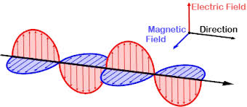
Radio Frequency Continued …
Notes:
Instructor Notes:
This image is a visual representation of an electromagnetic (EM) wave, commonly used to describe how radio frequency (RF) signals propagate through space.
Key Features:
Electric Field (Red): The red wave represents the electric field component of the EM wave. It oscillates vertically in a plane perpendicular to the direction of wave travel.
Magnetic Field (Blue): The blue wave represents the magnetic field component. It oscillates horizontally, also perpendicular to the direction of wave travel, but in a plane orthogonal to the electric field.
Direction of Propagation (Black Arrow): The wave travels in the direction indicated by the black arrow (to the right). This is perpendicular to both the electric and magnetic fields.
Explanation:
This orthogonal (right-angle) relationship between the electric field, magnetic field, and direction of travel is a defining characteristic of electromagnetic waves. Together, these fields carry energy through space at the speed of light. This is the foundation for all wireless communication—including Wi-Fi, Bluetooth, Zigbee, and other ICS wireless protocols.

Slide 7
Radio Frequency Bands in ICS and IoT
VLF/LF (3–300 kHz): Long range, very low data rate (e.g., submarine comms)
HF/VHF (3–300 MHz): Penetrates obstacles; used in legacy telemetry
UHF (300 MHz–3 GHz): Common in industrial Wi-Fi, Bluetooth, Zigbee
SHF (3–30 GHz): Used for microwave comms and radar
EHF (30–300 GHz, millimeter waves): High-bandwidth, short-range (5G/IoT)
Trade-offs: higher frequency = higher data rate but shorter range
Notes:
Instructor Notes:
The RF spectrum is divided into bands with distinct propagation characteristics.
VLF/LF (very low frequency and low frequency) are used in niche applications like submarine comms.
HF/VHF can penetrate buildings and are suitable for telemetry.
UHF is widely used in industrial protocols like Zigbee and Bluetooth, offering a balance of speed and range.
SHF (Super high frequency) supports high-throughput applications like radar, while EHF (Extremely high frequency) or millimeter waves enable extremely high-speed communication but have limited range and are susceptible to atmospheric attenuation.
Understanding these bands helps in selecting appropriate wireless technologies for ICS.

Slide 8
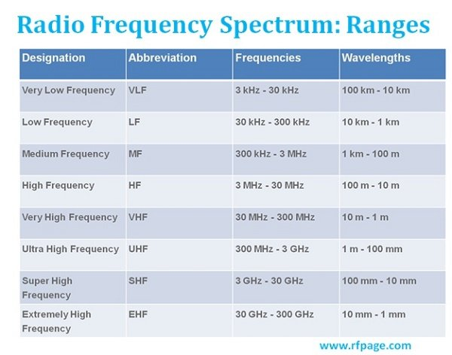
Radio Frequency Bands in ICS and IoT
Notes:
Instructor Notes:
Another perspective on RF Bands

Slide 9
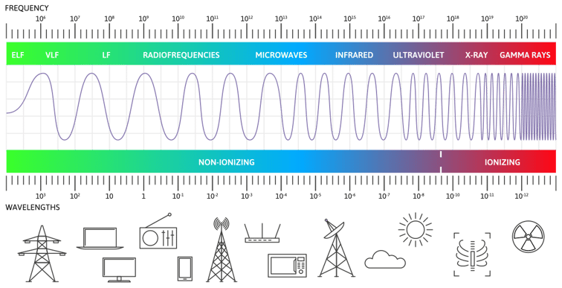
Radio Frequency Relationships
Notes:
Instructor Notes:
This image is a visual representation of the electromagnetic spectrum, illustrating the range of electromagnetic (EM) wave frequencies, their classification, and associated applications.
Key Elements in the Image:
Frequency and Wavelength Representation
The wave pattern illustrates how wavelength decreases and frequency increases from left to right.
On the left side, waves are long and infrequent (low frequency, long wavelength).
On the right side, waves are tightly packed and oscillate rapidly (high frequency, short wavelength).
Spectrum Breakdown (Left to Right):
Region Characteristics Applications/Icons Shown
ELF/VLF/LF Extremely low to low frequency. Longest wavelengths. Power lines, submarine comms
Radiofrequencies Common in broadcast and wireless communication. TVs, radios, mobile phones
Microwaves Shorter wavelength than RF; used in radar, Wi-Fi, microwave ovens. Cell towers, Wi-Fi routers
Infrared Heat radiation, short-range communication. TV remotes, thermal sensors
Ultraviolet Beyond visible light, can damage skin cells. Sun, sterilization equipment
X-rays High energy; penetrates soft tissue. Medical imaging
Gamma Rays Highest frequency, most energy; from nuclear sources. Nuclear physics, radiation therapy
Non-Ionizing vs. Ionizing:
The spectrum is divided into two regions:
Non-Ionizing Radiation (left side): Safe at low exposure, includes RF, microwave, IR.
Ionizing Radiation (right side): Can alter DNA and biological tissue, includes UV, X-rays, gamma rays.
Bottom Icons:
Visual symbols represent technologies and phenomena associated with each band, from electrical infrastructure and communications to sunlight and medical imaging.

Slide 10
Wireless Technologies in ICS
Increasing adoption due to cost, flexibility, and resilience benefits
Commonly replaces or augments wired infrastructure in ICS environments
Supports scalability and rapid deployment in large or remote areas
Key examples: WirelessHART, ISA100.11a, Zigbee, Z-Wave, Bluetooth, Microwave, Satellite
Notes:
Instructor Notes:
Wireless technologies are gaining momentum in ICS environments due to the high cost of running cables, difficulty of installation in remote areas, and need for flexible deployment. These technologies are particularly beneficial in environments where physical constraints limit wired connectivity—like pipelines, offshore platforms, and widely distributed sensors. They also provide redundancy to support fault-tolerant systems.
However, the decision to adopt wireless must be paired with strict security and reliability considerations, as they are inherently more vulnerable than their wired counterparts.

Slide 11
Overview of Key Wireless Protocols
WirelessHART: Mesh network based on IEEE 802.15.4 with time-synchronized communication
ISA100.11a: IPv6-compatible wireless mesh protocol for industrial process automation
Zigbee: Low-power protocol with tree/star/mesh topologies; used in building automation
Bluetooth: Short-range communication; newer BLE versions support low-latency control
Z-Wave: Proprietary mesh protocol with interoperability for smart infrastructure
Notes:
Instructor Notes:
WirelessHART builds on IEEE 802.15.4, using TDMA to coordinate time-synchronized, deterministic messaging. Each node routes data for others, forming a robust mesh managed centrally. AES-128 encryption and challenge-response authentication ensure security.
ISA100.11a supports IPv6 and legacy protocols, using a hybrid TDMA/CSMA approach and robust QoS controls.
Zigbee offers energy-efficient communication ideal for non-critical tasks.
Bluetooth, especially BLE, provides fast, short-range data exchange for diagnostics and sensor pairing.
Z-Wave is commonly found in smart building systems, using sub-GHz bands for low interference and robust signal propagation.

Slide 12
Specific Wireless Vulnerabilities
Weak or proprietary encryption in legacy protocols
Jamming susceptibility in shared RF bands (e.g., 2.4 GHz)
Battery exhaustion attacks on constrained devices
Poor key management practices in some standards
Lack of firmware update capability in field devices
Notes:
Instructor Notes:
Legacy protocols often lack strong encryption, relying on static or proprietary methods that are easily broken.
The use of common frequency bands makes ICS wireless systems vulnerable to jamming attacks.
Battery-powered devices may be rendered inoperable by energy depletion attacks.
Key management—especially lack of rotation or revocation—can leave networks exposed if one device is compromised.
Many field-deployed devices lack secure OTA update mechanisms, preventing timely patching of discovered vulnerabilities.

Slide 13
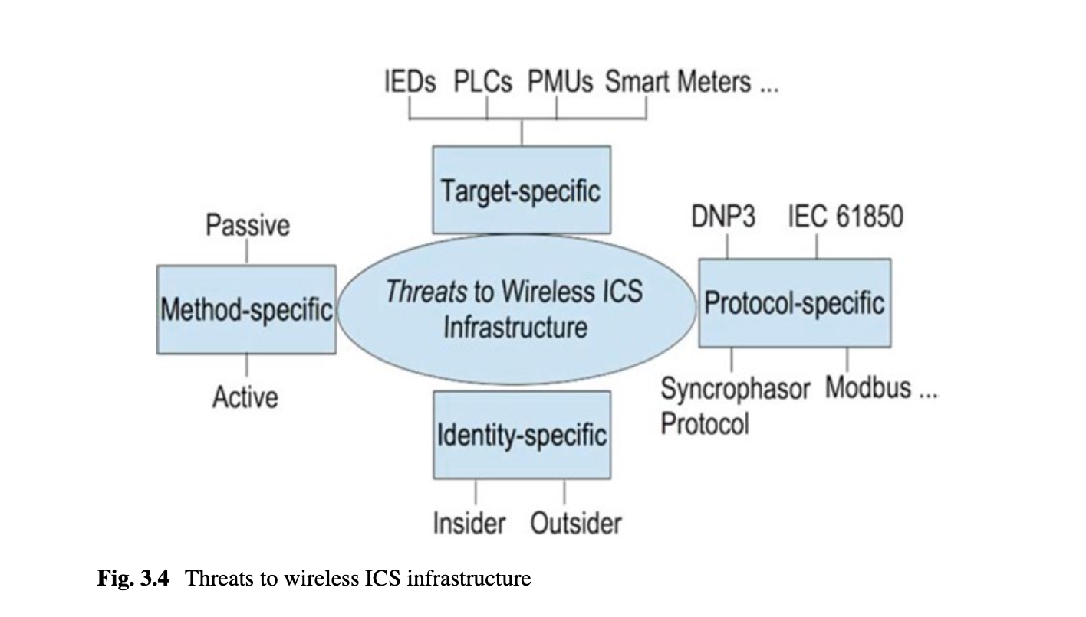
ICS Wireless Threat Modelling
Notes:
Instructor Notes:
This slide introduces a categorical framework for understanding threats to wireless Industrial Control System (ICS) infrastructure, adapted from the FIU case study and broader ICS security literature.
Method-Specific Threats:
Passive threats involve monitoring or intercepting communications without altering the signal (e.g., RF eavesdropping).
Active threats include signal jamming, injection, replay attacks, and impersonation of control messages—potentially causing unsafe operations or disruptions.
Target-Specific Threats:
These focus on specific ICS field devices such as:
IEDs (Intelligent Electronic Devices)
PLCs (Programmable Logic Controllers)
PMUs (Phasor Measurement Units)
Smart Meters
These devices, often deployed in unsecured or remote environments, become easy entry points if wireless communication is not encrypted or authenticated.
Protocol-Specific Threats:
Industrial protocols like Modbus, DNP3, and IEC 61850 were often designed without security in mind. When tunneled over wireless, their lack of encryption or authentication makes them especially vulnerable.
Protocol-aware attackers can inject false commands or disrupt synchronization in phasor-based protocols.
Identity-Specific Threats:
Insider threats involve employees or contractors who misuse access for sabotage or theft.
Outsider threats involve external attackers, including cybercriminals and nation-state actors who exploit vulnerabilities via wireless interfaces.
Multidimensional Security: This classification shows that defending ICS wireless networks requires layered defenses—technical controls (e.g., encryption, jamming detection), procedural controls (e.g., access management), and threat modeling that considers who, how, and what is being targeted.

Slide 14
Wireless Threat Models in ICS
Method-specific: Passive (eavesdropping), Active (jamming, spoofing)
Target-specific: PMUs, PLCs, RTUs, Smart Meters
Protocol-specific: Exploits in DNP3, Modbus, IEC 61850 over wireless
Identity-specific: Insider vs. outsider threats
Notes:
Instructor Notes:
Wireless threats in ICS can be categorized by how they are carried out and what they target.
Passive threats like eavesdropping may expose sensitive control data, while active threats like jamming can disrupt operations.
Devices such as PMUs (phase measurement units) and RTUs are frequent targets, especially if located in exposed or unmanned areas.
Protocol vulnerabilities become critical when unsecured legacy protocols are tunneled over wireless.
Insider threats are particularly dangerous due to physical and logical access to devices and infrastructure.

Slide 15
Implementing Wireless ICS Security Features
Confidentiality: Secure encryption protocols (e.g., AES-128)
Authentication: Mutual verification of devices and users
Integrity: Message verification and tamper detection
Access Control: Role-based or attribute-based restrictions
Availability: Defense mechanisms against jamming and flooding
Accountability: Logging and audit trails for incident forensics
Notes:
Instructor Notes:
Security in wireless ICS systems requires multiple layers.
Confidentiality through encryption like AES-128 ensures data privacy.
Authentication mechanisms prevent unauthorized access to devices and control systems.
Integrity checks ensure messages are not tampered with in transit.
Access control mechanisms enforce user and device privileges.
Availability must be preserved even under duress from jamming or DoS attacks.
Finally, accountability through logging provides audit trails for both compliance and post-incident investigations.

Slide 16
Case Study – FIU Smart Grid Testbed
Real-world hybrid AC/DC Smart Grid platform at Florida International University (FIU)
Integrates renewable energy emulators: solar, wind, fuel cells
Includes wireless-enabled PMUs, PLCs, IEDs for live control experiments
Designed for research in islanding, control strategies, and cybersecurity
Notes:
Instructor Notes:
FIU’s Smart Grid Testbed provides a controlled environment to evaluate wireless ICS systems. It combines AC and DC buses with emulated renewable sources to simulate complex grid scenarios. Wireless versions of PMUs, PLCs, and IEDs are used to transmit data and execute control operations in real time. This environment allows researchers and students to explore challenges in wireless reliability, latency, and cybersecurity.

Slide 17
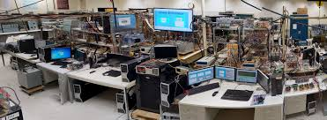
Case Study – FIU Smart Grid Testbed
Notes:
Instructor Notes:
Image of FIU’s Smart Grid Testbed for ICS.

Slide 18
Wireless PMU and PLC Architecture
PMUs include GPS receiver, ADCs, microcontrollers, and wireless transceivers
Each PMU calculates voltage/current phasors and timestamps via GPS
PLCs manage relays, switches, and power routing using wireless control
Centralized controller collects data from PMUs via a wireless mesh network
Notes:
Instructor Notes:
Wireless PMUs in the testbed use ADCs to sample power signals, GPS for precise timestamping, and microcontrollers for phasor calculation. Data is transmitted wirelessly using IEEE 802.15.4 or Wi-Fi modules. PLCs are similarly equipped with wireless interfaces to receive commands and control actuators. Data from PMUs is aggregated by a centralized controller, which uses the wireless mesh to maintain real-time awareness of the system’s state.

Slide 19
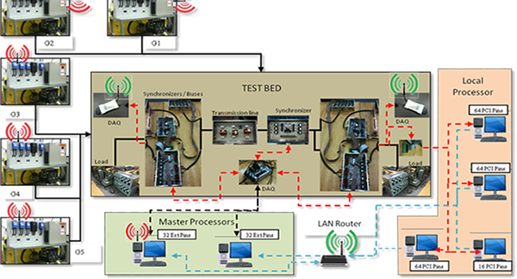
Case Study – FIU Smart Grid Testbed
Notes:
Instructor Notes:
Image of FIU’s Smart Grid Testbed for ICS.

Slide 20
Wireless Islanding Detection and Recovery
PMUs detect frequency drops and voltage instability to flag islanding
Optimization algorithm triggers load shedding or generation start-up
PLCs wirelessly execute disconnect or reroute commands to stabilize system
Wireless mesh ensures continued operation during communication failures
Notes:
Instructor Notes:
Islanding occurs when a part of the grid is electrically separated from the main utility. Wireless PMUs monitor frequency and voltage, triggering detection logic when anomalies arise. Optimization algorithms evaluate whether to shed load or activate local generation to maintain balance. PLCs then execute corrective actions wirelessly. The mesh network supports resilience by ensuring commands can reach devices even when some links are down.

Slide 21
Wireless Communication Stack in the Testbed
Physical Layer: IEEE 802.15.4 (Zigbee/WirelessHART PHY)
Network Layer: Mesh routing and link monitoring protocols
Transport Layer: Custom UDP over wireless for low-latency commands
Application Layer: Phasor data exchange and control instructions
Notes:
Instructor Notes:
The communication stack in the testbed uses 802.15.4 at the PHY/MAC layer, providing robust, low-power wireless transport. A mesh routing layer ensures connectivity and reroutes around failures. UDP is used for low-latency delivery of control messages, avoiding the overhead of TCP. The application layer manages phasor reporting, control command issuance, and diagnostics.

Slide 22
Lessons Learned from the FIU Testbed
Wireless ICS is feasible for real-time grid control with careful design
Security challenges include key distribution and jamming resistance
Wireless mesh adds fault tolerance and adaptability
Serves as a valuable research, training, and testing platform for ICS cybersecurity
Notes:
Instructor Notes:
The testbed proves wireless control is viable even for time-sensitive applications, if properly secured and architected. However, vulnerabilities in key management and RF jamming persist. The mesh topology provides strong fault tolerance, making the network self-healing. As a training environment, the testbed allows hands-on exploration of wireless ICS systems, including their vulnerabilities and defenses.
INL also has a wireless testbed.
Mention how students can build their own home labs using physical IoT devices and VMs to simulate an ICS with wireless technologies.

